Slide 1
Aligning Benefit-Cost Analysis with State Climate Goals
Matt Rusteika
Buildings Lead & Senior Policy Analyst

Slide 2
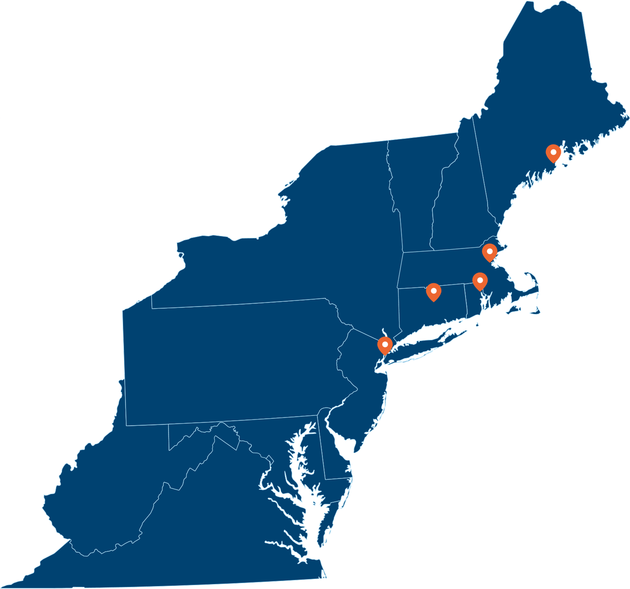
Acadia Center: About Us
Mission: Acadia Center is a non-profit research and advocacy organization committed to advancing the clean energy future. It works to empower consumers and offer real-world solutions to the climate crisis.
Programs: Acadia Center coordinates programs across 6 initiatives: Buildings, Transportation, Clean Power, Utility Innovation, Fossil Fuel Phase Out, and Public Engagement
Support: Acadia Center is funded by foundation grants and individual donations. It does not accept corporate or government funding.

Slide 3

Why are we talking about this?
Efficiency is our lowest-cost energy resource, but prices—and therefore investment decisions—don’t reflect climate or equity concerns
  Cost-effectiveness analysis is mostly a price comparison
  Can we reform BCA while retaining what’s good about current programs?

Slide 4
Summary
Social cost of carbon adds benefits, but it can’t be expected to change the measure mix all by itself.
Segmentation can help programs take advantage of situations where EE and GHG impacts are both maximized.
Marginalized communities are “underserved” because programs don’t assign value to serving them.
Gas-to-ASHP fuel switching is cheaper than doing nothing.
Electrification could reduce rates over time by spreading new electricity costs over more kilowatt-hours.
The climate, equity, health, and safety benefits of efficiency can exceed its energy benefits in many situations.

Slide 5
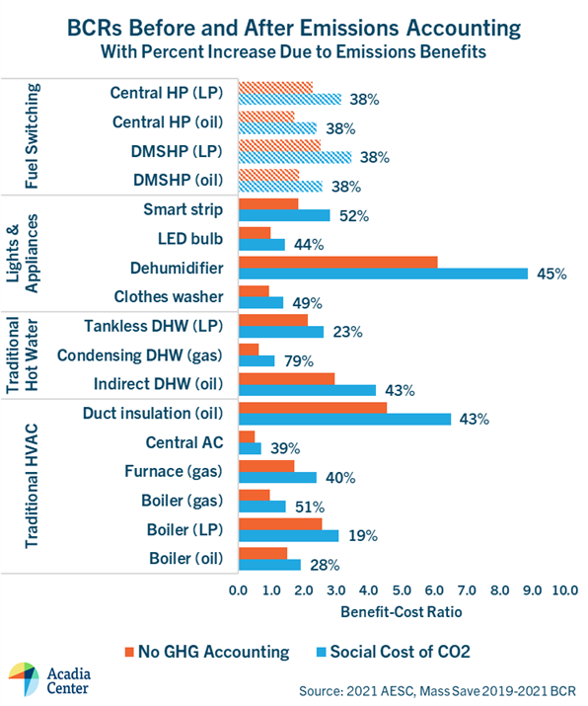
1. Social cost of carbon can’t do it alone
Maximizing GHG reduction means shifting measure mix
Social cost of carbon increases benefits for every measure
  But changes to the BCR are about the same across measures
Every EE measure has GHG impact—if we want to change measure mix, we need other reforms aside from SCC

Slide 6
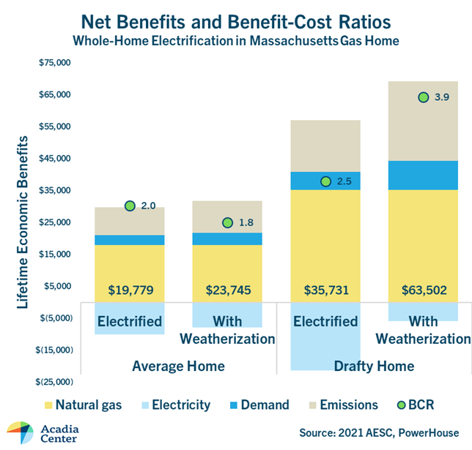
2. Changes to program design can go a long way
Top-down: if PAs hit savings goals, nothing else is needed
  So why do all this other stuff?
Segmentation can help programs fulfill other policy imperatives
Segmentation can also change BCA picture
  E.g., targeting super-drafty homes for electrification & weatherization generates huge net benefits

Slide 7
3. Programs need to promote EJ
Low- and moderate-income households have not had equal access to energy efficiency program incentives
Enlisting these households in programs can be hard:
  They often don’t control their energy use decisions
  They don’t have disposable income
  They don’t have the time to do leg work
  They might not speak English
The more resources programs spend on enlisting “underserved” participants, the more pressure on cost-effectiveness
  The value of savings needs to outstrip these extra costs
Setting aside funding for engagement can help
  Fund grassroots community orgs to find & enlist households & small businesses

Slide 8
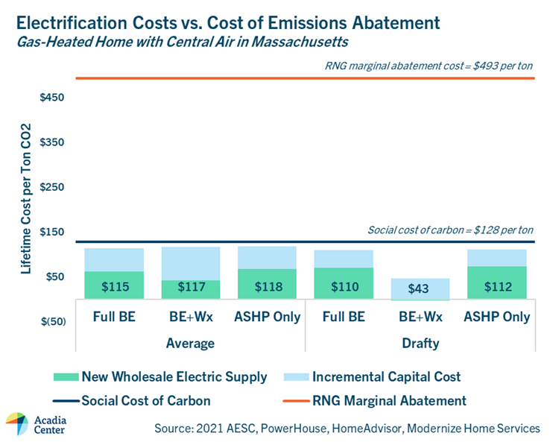
4. Gas-to-ASHP is cheaper than doing nothing
Electrification costs money
  Incremental capital cost
  Electric capacity costs
But the costs of electrification are less than the social cost of carbon
This comparison can help bring EE out of its silo
  There is real value to avoiding or adapting to the impacts of climate change

Slide 9
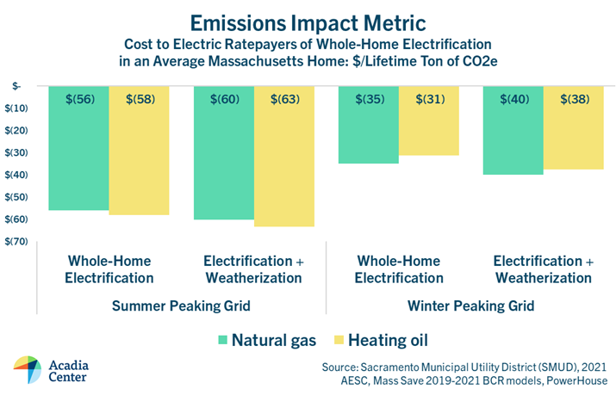
5. Electrification may reduce rates over time
Serving new load costs money
Selling new kWh makes money
Potential revenue exceeds new costs
  This is SMUD’s “super RIM” adapted for Massachusetts

Slide 10
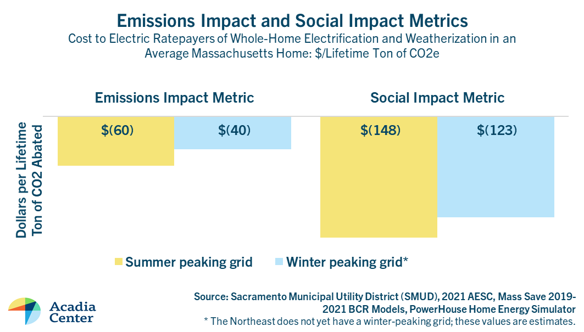
6. Social benefits may dwarf energy impacts
NEI research has generated some big health values
  Asthma, etc.
Accounting for those impacts can more than double benefits
Health & safety may come to far exceed all other benefits
  What then?

Slide 11
Matt Rusteika
Buildings Director & Senior Policy Analyst
mrusteika@acadiacenter.org
617-742-0054 x108

